Slide 1
SWIFT CART
Enhanced shopping with RFID
Sweatha R (210701275)
Thamizh Bharathi M (210701288)

Slide 2
Table Of Contents
Abstract
Introduction
Objectives
Literature survey
Existing System
Proposed Solution
Modules
System Architecture
Conclusion
Future Enhancements
References

Slide 3
Abstract
The SwiftCart project introduces an RFID-enabled automated billing system to streamline retail checkout processes. Through seamless item scanning, users access detailed product information on an LCD screen and view dynamically updated electronic bills on their mobile devices. A removal button allows for easy modification of selections, ensuring accuracy. Real-time notifications in the LCD display provide comprehensive purchase records, enhancing transparency and convenience. SwiftCart aims to optimize retail operations and enhance customer experiences through innovative technology.

Slide 4
Introduction
In today's fast-paced world, traditional checkout processes often lead to long queues and manual errors, impacting both customer satisfaction and operational efficiency. SwiftCart emerges as a game-changer, offering an RFID-enabled automated billing system designed to alleviate these challenges. By seamlessly integrating RFID technology with intuitive user interfaces, SwiftCart enables swift item scanning, real-time bill updates, and easy modification of selections. With its innovative features, including notifications in the LCD display for comprehensive purchase records, SwiftCart aims to redefine the retail shopping experience, setting new standards for efficiency, convenience, and customer satisfaction.

Slide 5
Objectives
1. Streamline retail checkout process
2. Intuitive item scanning interface
3. Real-time electronic billing
4. Easy selection modification
5. Instant notifications in the LCD display
6. Scalable system optimization

Slide 6
Literature Survey
The research paper published in 2008 [1] provided insights on how RFID enabled one-to-one interactions. This paper served as the basis for our idea, which we are currently developing.
Another paper published in 2011 [2] gave us insights into how RFID helped us understand the role of RFID in the supply chain market.
Furthermore, a paper published in 2021 [3] provided us with details on how to store the data collected from sensors and manage them effectively, especially in large-scale applications.
Additionally, a book published in 2010 [4] provided us with all the information about what RFID can and cannot do. It helped our project seamlessly integrate with third-party services.

Slide 7
Existing System
The existing system in the retail industry relies heavily on manual checkout processes, which often result in long queues and errors in billing. Customers have to wait in line for their items to be scanned and manually inputted for billing, leading to delays and frustration.
Additionally, data management in large-scale applications poses challenges due to the lack of efficient storage and organization methods. This can result in data loss, inconsistency, and difficulties in analysis.
Moreover, existing RFID applications primarily focus on one-to-one interactions or tracking items within the supply chain.

Slide 8
Proposed Solution
Introducing an RFID-enabled automated billing system for retail settings, our solution streamlines checkout processes. Customers use RFID-equipped cards to scan items, with detailed information displayed on an LCD screen for transparency and also they can choose for modifications. The system ensures swift checkout, minimizing queues and errors associated with manual processes. With seamless integration and real-time updates, it enhances efficiency and customer satisfaction in retail environments.

Slide 9
Modules
Arduino UNO
Bread Board
Buzzer
RFID reader modules
RFID tags
LCD Display
Jumper wires
Red and Green LEDs

Slide 10
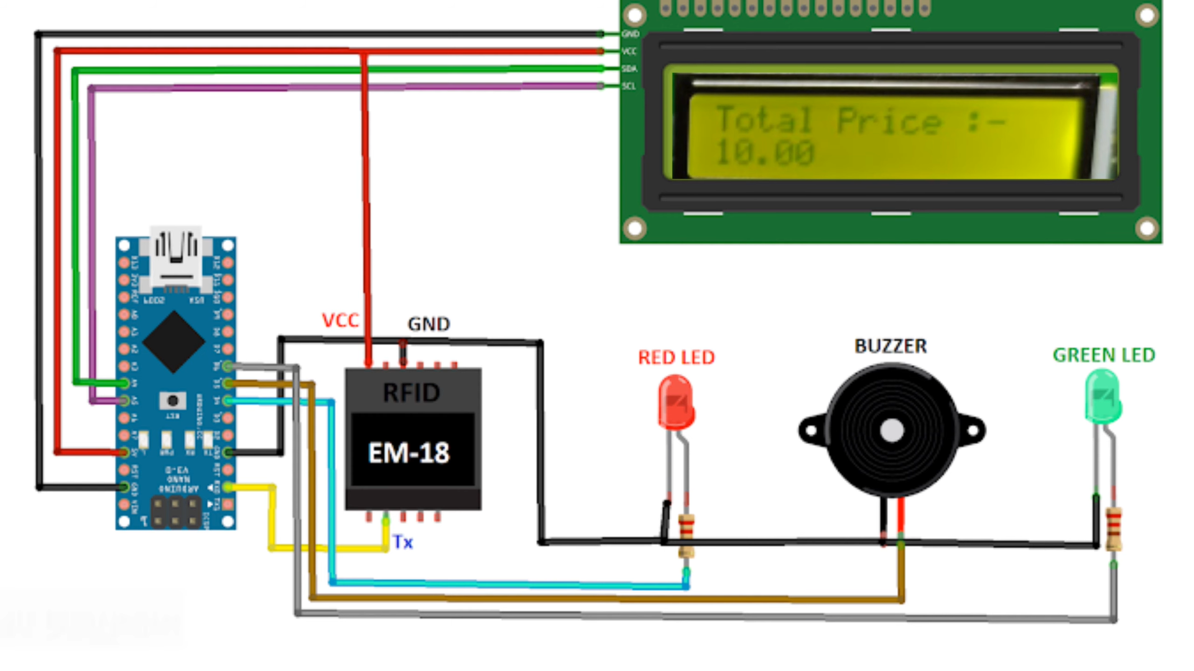
System Architecture

Slide 11
Conclusion
Our RFID-enabled automated billing system represents a significant advancement in retail technology, addressing the inefficiencies of traditional checkout processes. By leveraging RFID technology, we have successfully streamlined the checkout experience, reducing queues and errors while enhancing transparency for customers. With its seamless integration and real-time updates, our system not only improves operational efficiency but also enhances overall customer satisfaction. Moving forward, we envision widespread adoption of this technology across various retail settings, further revolutionizing the shopping experience for consumers worldwide.

Slide 12
Future Enhancements
Integration with Mobile Payment Systems: Enhance convenience by integrating the SwiftCart system with popular mobile payment platforms, allowing customers to pay directly through their smartphones.
Personalized Recommendations: Utilize RFID data to provide personalized product recommendations based on past purchases, enhancing the shopping experience and driving sales.
Inventory Management Integration: Integrate the SwiftCart system with inventory management software to automatically update stock levels in real-time, optimizing inventory control and reducing stockouts.
Loyalty Program Integration: Implement a loyalty program feature where customers can earn rewards or discounts based on their shopping habits tracked through RFID technology, fostering customer loyalty.

Slide 13
References
[1] L. B. Ayre, RFID in Libraries: A Step Toward Interoperability. American Library Association, 2012.
[2] P. Reyes, RFID in the Supply Chain. McGraw Hill Professional, 2011.
[3] K. B. Prakash, J. Nayak, B. tp Madhhav, S. Padmanaban, and V. E. Balas, Big Data Analytics and Intelligent Techniques for Smart Cities. CRC Press, 2021.
[4] K. Finkenzeller, RFID Handbook: Fundamentals and Applications in Contactless Smart Cards, Radio Frequency Identification and Near-Field Communication. John Wiley & Sons, 2010.

Slide 14

Thank you!

